Slide 1
Chess games classification
Faculty of Economic Science
Economics
Moscow, 2022
Team: Adilkhan Sanzhar, Kozachenko Maksim, Kyu Daniil, Sonin Artemiy

Slide 2
Data description
Faculty of Economic Science
Chess games classification
Data [1 / 4 ]
Source: https://database.lichess.org
We parsed information about 200.000 chess
games played in 2019.
Collected DataFrame has 623 columns.
Main regressors:
Black_elo (int) - rating elo of who plays for black
White_elo (int) - rating elo of who plays for white
eval_ply_{i} (float) - stockfish’s evaluation of position after
after i-th turn (we have data about 200 turns)
clock_ply_{i} (float) - the rest of timebank after after i-th turn
Time_control (categorial) - time format of a game
delta_ply_{i} (float) - change in stockfish’s evaluation after
i-th turn
Termintion_type (categorial) - the cause of the game finish

Slide 3
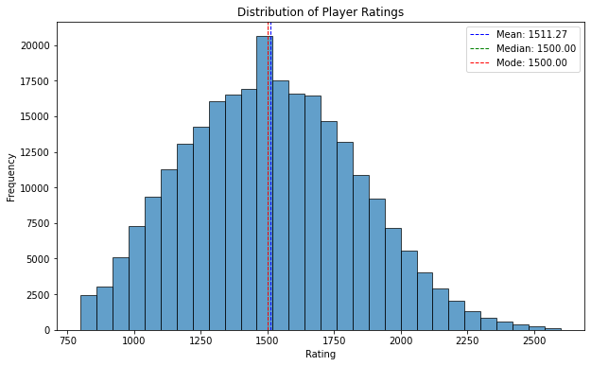
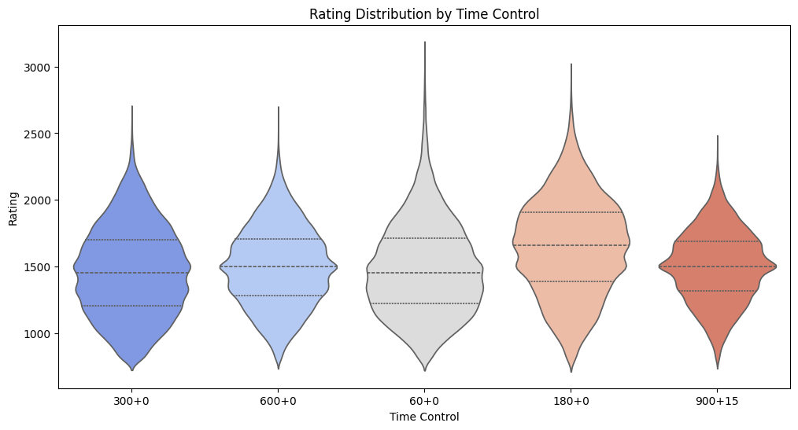
Faculty of Economic Science
Chess games classification
Data [2 / 4 ]
Rating distribution among different time control groups is similar

Slide 4
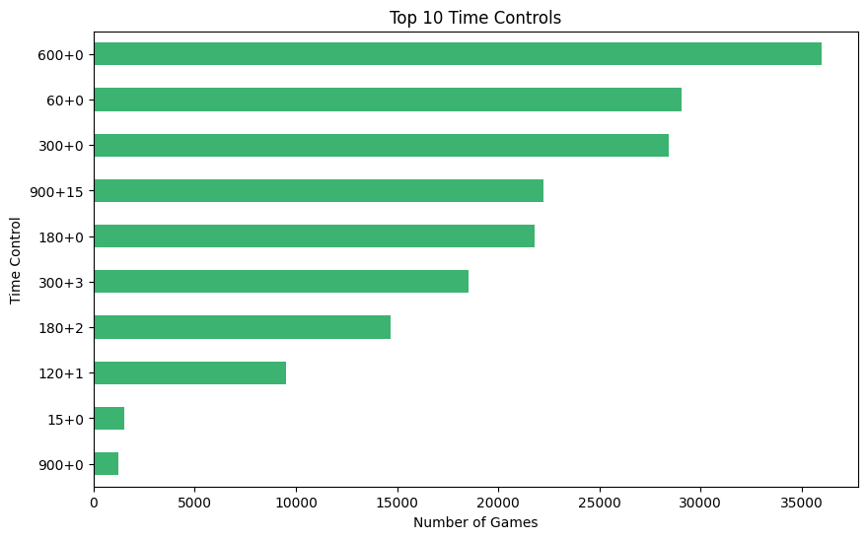
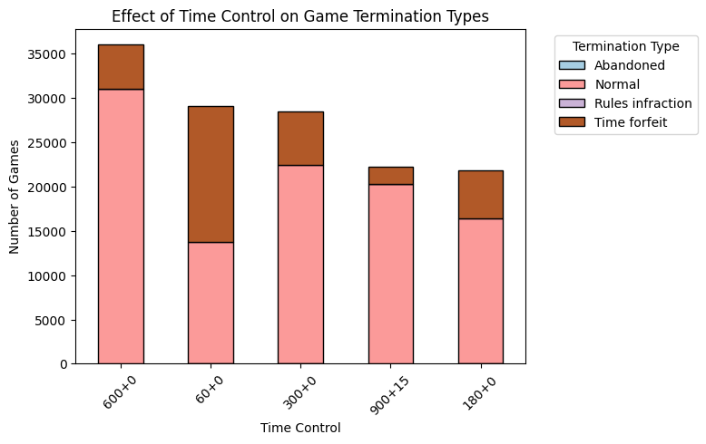
Faculty of Economic Science
Chess games classification
Data [3 / 4 ]
The most common time controls
are “60+0” and “600+0”
The faster the format, the more often
games end due to time running out

Slide 5
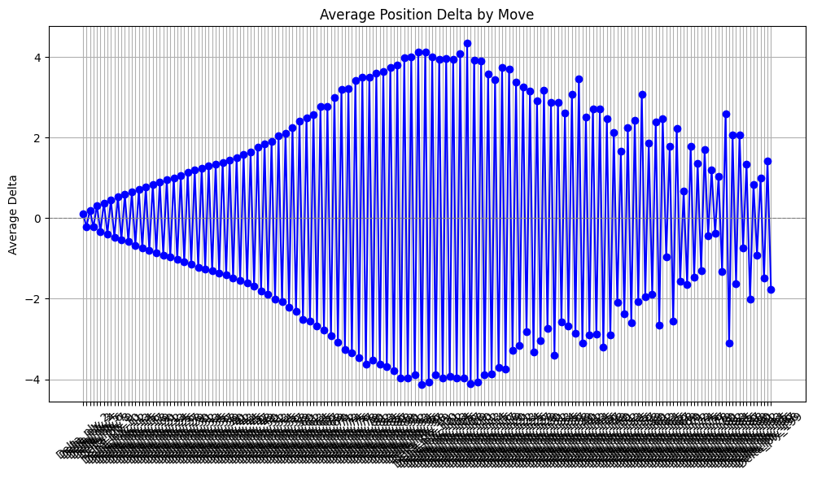
Faculty of Economic Science
Chess games classification
Data [4 / 4]
The key regressors we use in our
models are the change of change in Stockfish’s evaluation after
i-th turn. The plot shows an average change depending turn number.
The plot shows that the “easiest” part of chess is debut, in the middlegame players make the most mistakes.

Slide 6
Random Forest + GridSearchCV
Faculty of Economic Science
Chess games classification
Baseline models [1 / 3]
We divided our data into two parts: games where played two strong players (rating elo >=2000) and games where played two weak players (rating elo <= 1500). The classifier predicts the class of the game for time control = ‘60+0’.
RandomForestClassifier(max_depth=None, random_state=42, n_estimators=100)
ROC-AUC: 0.9262134910897879 Accuracy: 0.9342977697408077
param_grid = {
'n_estimators': [50, 100, 200],
'max_depth': [None, 5, 10, 15],}
Classification Report | precision | recall | f1-score | support
Weak | 0.94 | 0.99 | 0.86 | 2987
Strong | 0.82 | 0.44 | 0.57 | 331
macro avg | 0.88 | 0.71 | 0.77 | 3318
weighted avg | 0.93 | 0.93 | 0.93 | 3318

Slide 7
Logistic Regression + GridSearchCV
Faculty of Economic Science
Chess games classification
Baseline models [2 / 3]
The classifier predicts the class of the game for time control = ‘60+0’ (Bullet).
LogisticRegression(solver='liblinear', C=10, penalty='l1', random_state=42)
ROC-AUC: 0.9169442205245895 Accuracy: 0.9318866787221217
Classification Report | precision | recall | f1-score | support
Weak | 0.95 | 0.98 | 0.96 | 2987
Strong | 0.74 | 0.49 | 0.59 | 331
macro avg | 0.84 | 0.74 | 0.78 | 3318
weighted avg | 0.92 | 0.93 | 0.93 | 3318
param_grid = {
'C': [0.01, 0.1, 1, 10, 100],
'penalty': ['l1', 'l2'],
}

Slide 8
Gradient Boosting + GridSearchCV
Faculty of Economic Science
Chess games classification
Baseline models [3 / 3]
The classifier predicts the class of the game for time control = ‘60+0’ (Bullet).
GradientBoostingClassifier(learning_rate=0.1, n_estimators=150, subsample=0.8)
ROC-AUC: 0.9459442205245895 Accuracy: 0.9379144062688366
param_grid = {
'n_estimators': [50, 100, 150],
'learning_rate': [0.01, 0.1],
'subsample': [0.8, 1.0]
}
Classification Report | precision | recall | f1-score | support
Weak | 0.95 | 0.98 | 0.97 | 2987
Strong | 0.76 | 0.55 | 0.64 | 331
macro avg | 0.86 | 0.76 | 0.80 | 3318
weighted avg | 0.93 | 0.94 | 0.93 | 3318

Slide 9
Neural Network
Faculty of Economic Science
Chess games classification
Neural Network [1 / 2]
Model type: Feedforward Neural Network
Model structure:
Input layer:
128 neurons
Activation: ReLU
Input data: 149 features
Normalization layer:
Batch Normalization
Regularization layer:
Dropout (0.3)
Hidden layer:
64 neurons
Activation: ReLU
Normalization layer:
Batch Normalization
Regularization layer:
Dropout (0.3)
7. Hidden layer:
32 neurons
Activation: ReLU
8. Normalization layer:
Batch Normalization
9. Regularization layer:
Dropout (0.3)
10. Hidden layer:
16 neurons
Activation ReLU
11. Normalization layer:
Batch Normalization
12. Regularization layer:
Dropout (0.3)
13. Output layer:
1 neuron
Activation: Sigmoid (probability to be ‘strong’)

Slide 10
Neural Network
Faculty of Economic Science
Chess games classification
Neural Network [2 / 2]
Model compilation:
Optimizer: Adam (learning rate = 0.001)
Loss Function: binary cross-entropy
Metrics: (Accuracy)
Learning parameters:
Number of epochs: 30
Batch size: 64
Validation split: 20%
Classification Report | precision | recall | f1-score | support
Weak | 0.96 | 0.96 | 0.96 | 2987
Strong | 0.62 | 0.60 | 0.61 | 331
macro avg | 0.79 | 0.78 | 0.78 | 3318
weighted avg | 0.92 | 0.92 | 0.92 | 3318
Test loss: 0.20001919567584991,
Test accuracy: 0.9231464862823486
ROC-AUC of the model: 0.9180598302614452
The quality metrics turned out to be worse than those of Gradient Boosting.

Slide 11
Stacking Model
Stacking Model
Faculty of Economic Science
Chess games classification
Stacking Model [1 / 2 ]
Base models
model1 = LogisticRegression(random_state=42)
model2 = RandomForestClassifier(n_estimators=150, random_state=42)
model3 = GradientBoostingClassifier(learning_rate=0.1, n_estimators=150, subsample=0.8)
meta_model = LogisticRegression(random_state=42)
Estimated weights of baseline models in meta_model:
logreg - 2.34197332
rf - 3.84485306
gb - 2.15150315

Slide 12
Stacking Model
Faculty of Economic Science
Chess games classification
Stacking Model [2 / 2 ]
Accuracy of Stacking Model: 0.9373116335141651
ROC-AUC of Stacking Model: 0.9412782682662131
Classification Report | precision | recall | f1-score | support
Weak | 0.95 | 0.98 | 0.97 | 2987
Strong | 0.77 | 0.53 | 0.63 | 331
macro avg | 0.86 | 0.76 | 0.80 | 3318
weighted avg | 0.93 | 0.94 | 0.93 | 3318
Model showed good quality, but Gradient Boosting model still has a bit better Roc-Auc.

Slide 13
Summary
Faculty of Economic Science
Chess games classification
]Summary

